Slide 1

Graph Databases for Business Analytics Workshop #1 Setup
Introduction to Graph Databases, T1, 2021

Slide 2
What is a Graph Database?
A modern type of NoSQL database that stores both data and the relationships between them
What this means is that each data record also stores the connections to entities that it is related to
Does not store data in tables [rows and columns] like legacy databases
Artificial Intelligence Augmented – to understand the nature or context of the relationships between entities

Slide 3
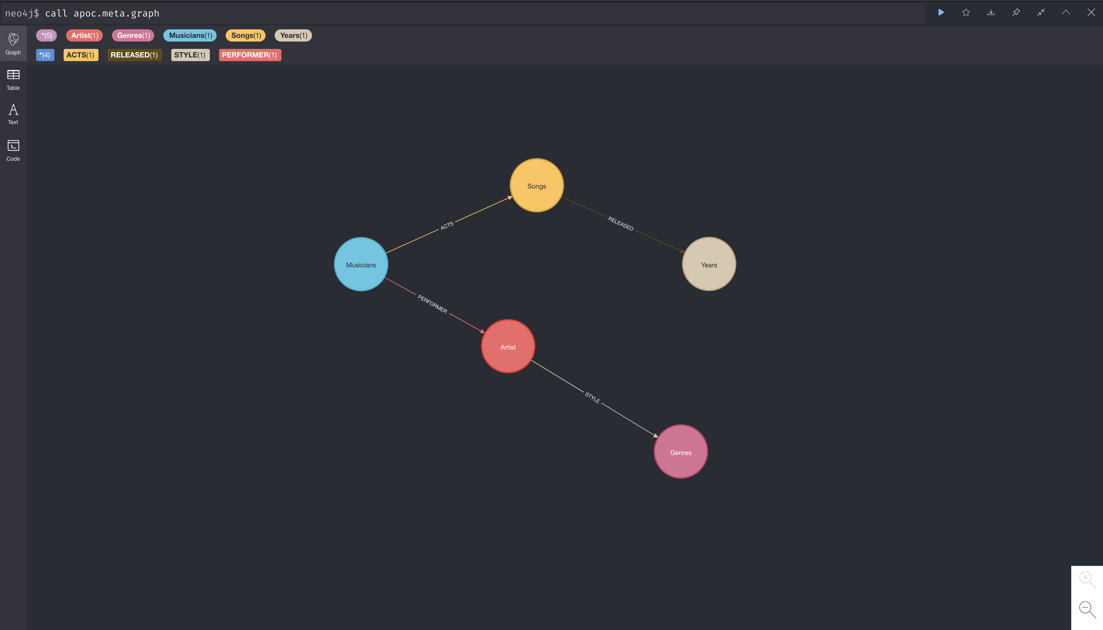
Graph Databases – Patterns of Relationships
What we truly want to know is how entities are related (or not related) to each other entities
How are things connected to each other?

Slide 4


Slide 5
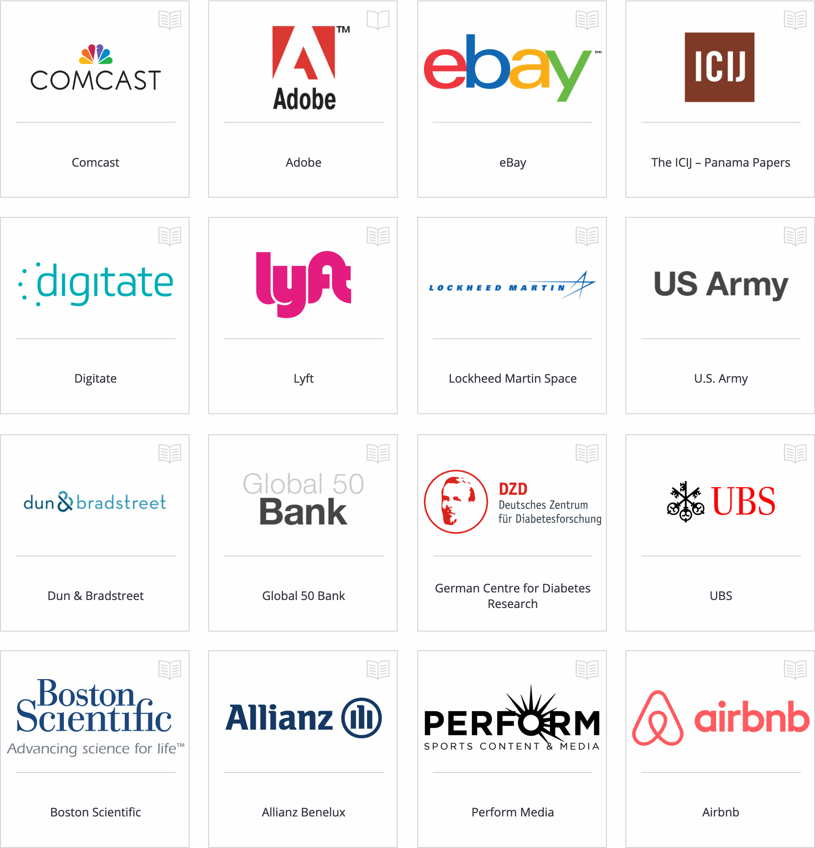

Slide 6
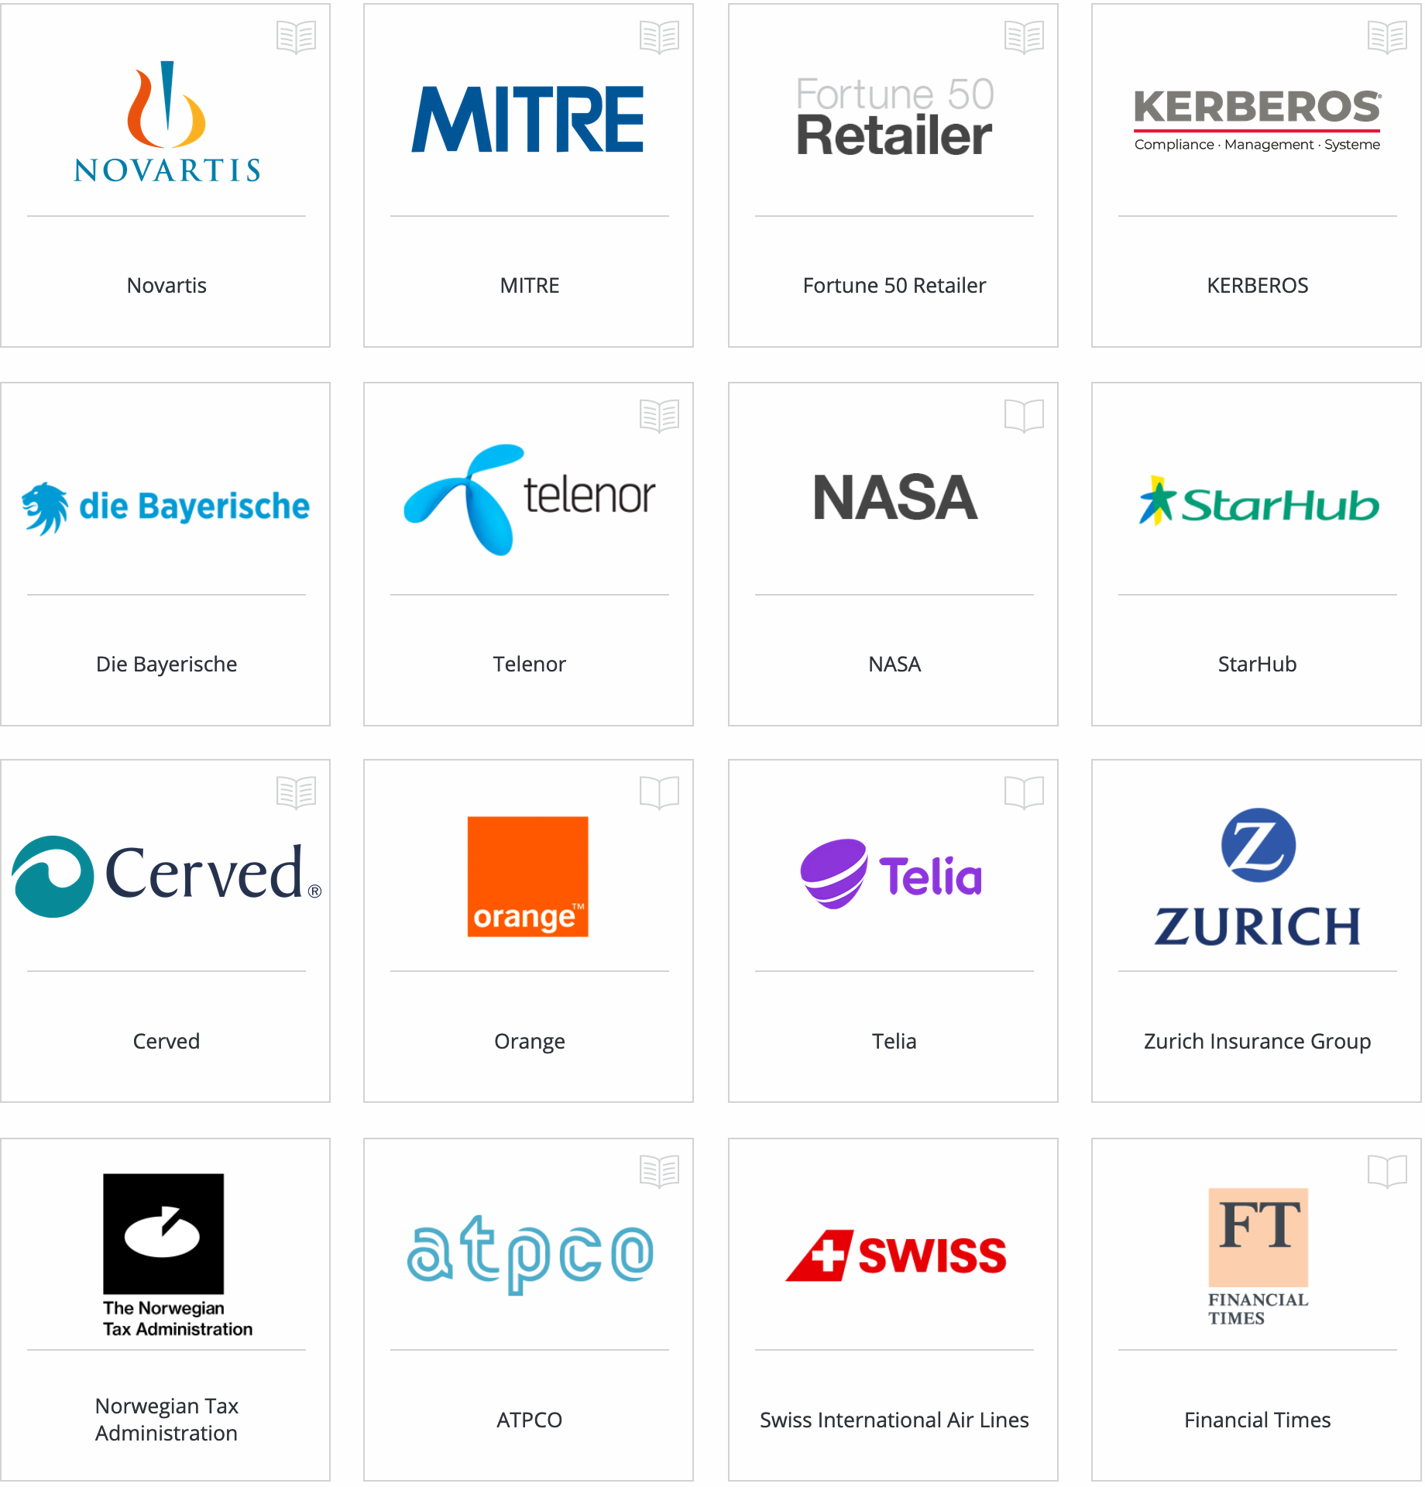

Slide 7


Slide 8


Slide 9


Slide 10


Slide 11
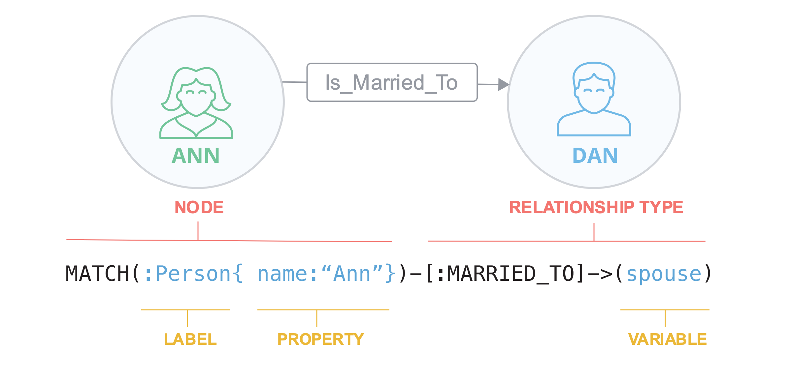

Slide 12
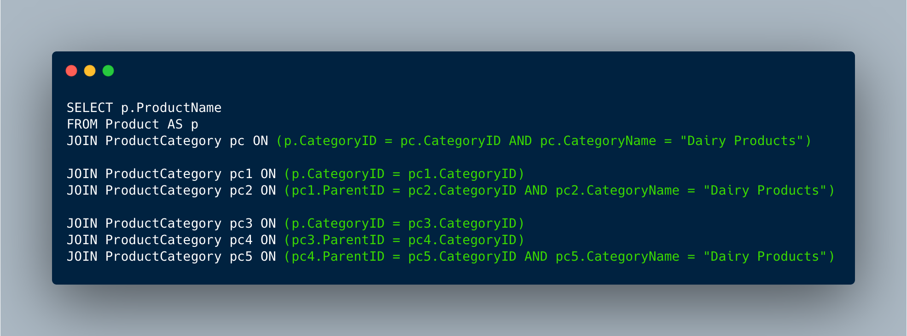
Legacy SQL Query

Slide 13
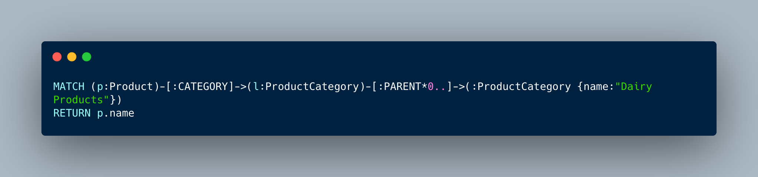
Cypher SQL Query

Slide 14
Development Environments & Tools
Neo4j: https://neo4j.com/

Slide 15
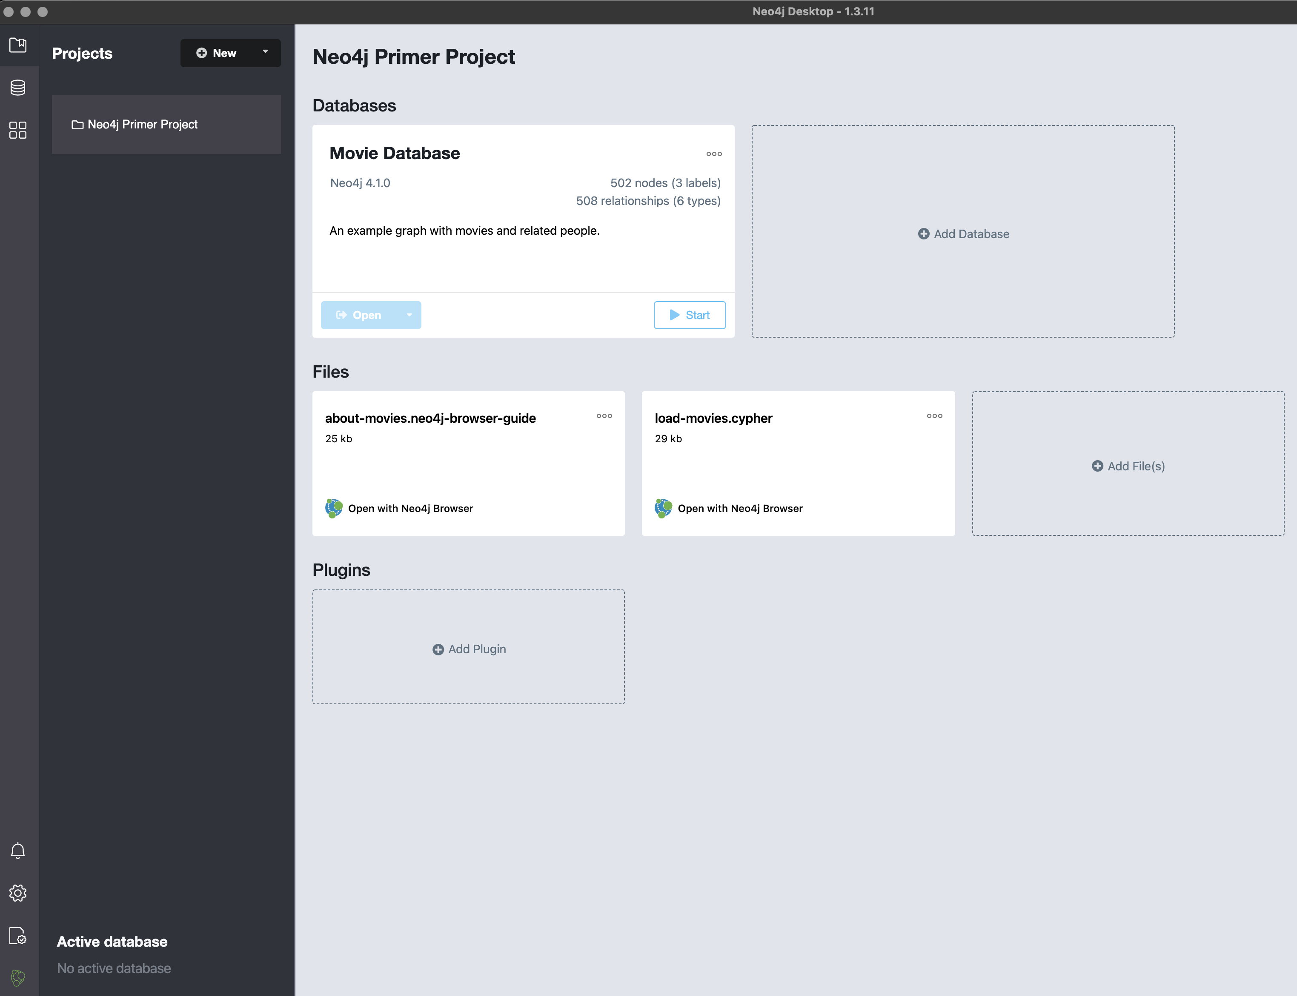
Neo4j User Environment
Start up: the project browser
On the left is the navigation & control panel

Slide 16
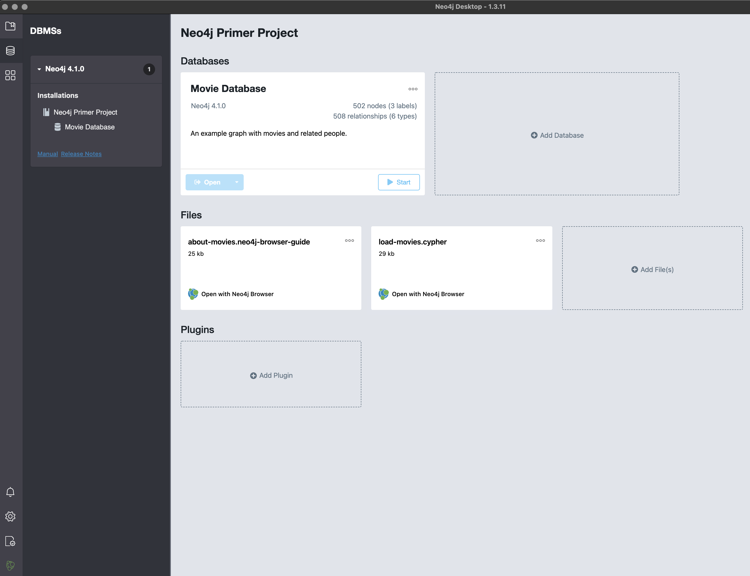
DBMS Tab

Slide 17
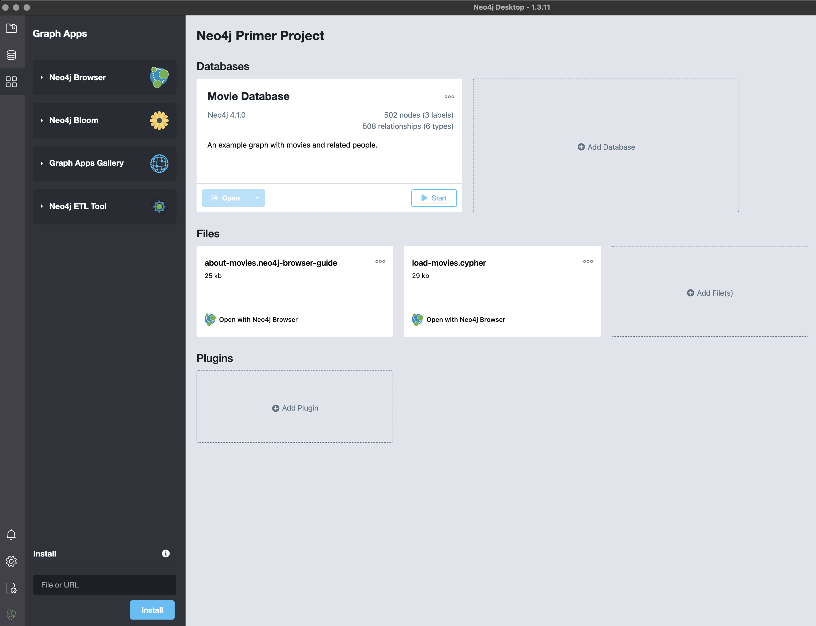
Graph Apps Tab
Neo4j Browser – but must start database first
Neo4j Bloom – the visualizer
Graph Apps Gallery
Neo4j ETL (Extract, Transform & Load)

Slide 18
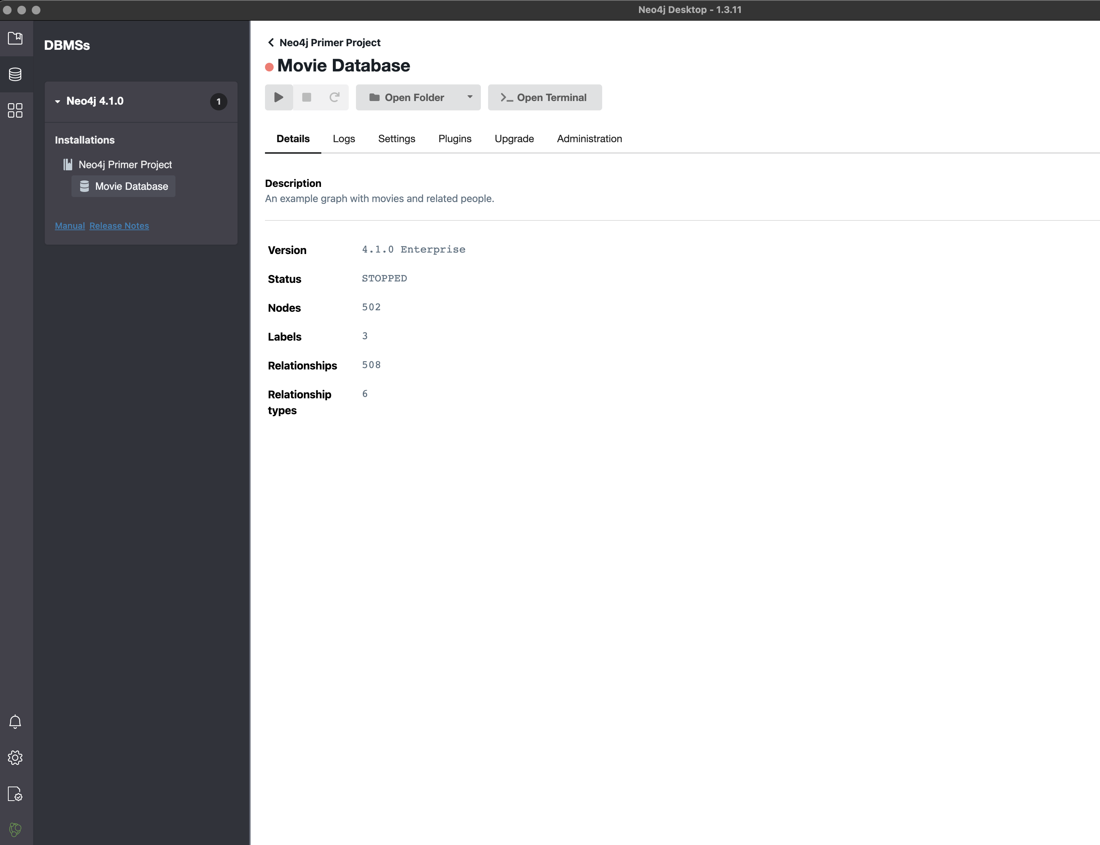
Start Database
Start by using the Play button
Once started we can use Neo4j Browser & Bloom

